Slide 1

Morphological and Super resolution Applications
Presented by: Ali Yehia
Supervised by: Dr. Dina Ragab
EC567: Image Signal Processing

Slide 2
Contents
Brief overview of image processing and its importance in various fields.
super-resolution and morphological image processing
1

Slide 3
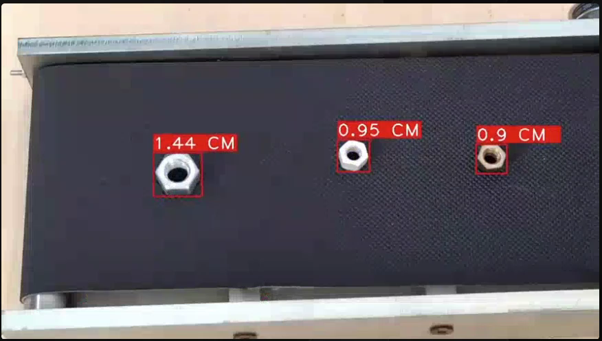
Introduction
Computer vision heavily relies on image processing techniques to analyze and interpret visual data. Image processing involves manipulating images to improve their quality or extract useful information. In computer vision, these processed images are then used as inputs for algorithms to perform tasks such as object detection, facial recognition, and scene understanding.
2

Slide 4
Super-Resolution Imaging
Techniques used in super-resolution to enhance image quality.
Single-Image Super-Resolution (SISR) methods.
Multi-Image Super-Resolution (MISR) methods.
3

Slide 5
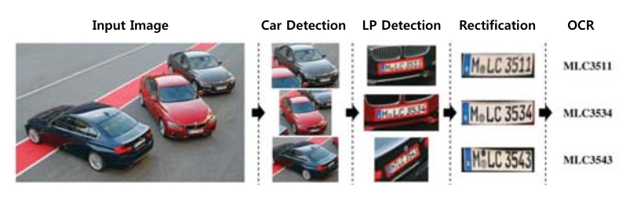
Super-Resolution Application
4

Slide 6
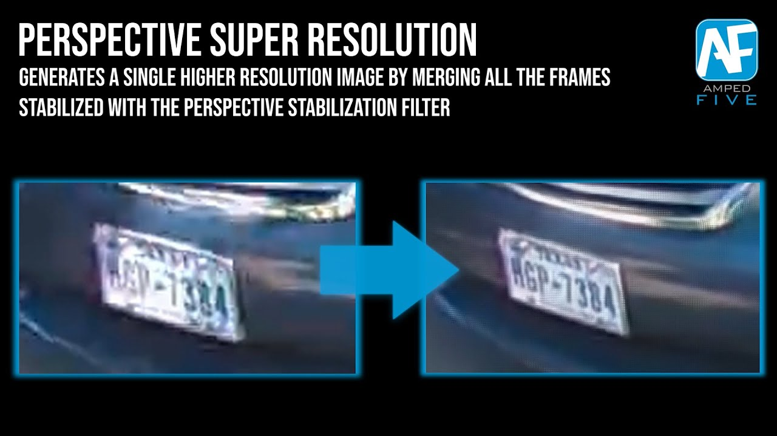
5

Slide 7
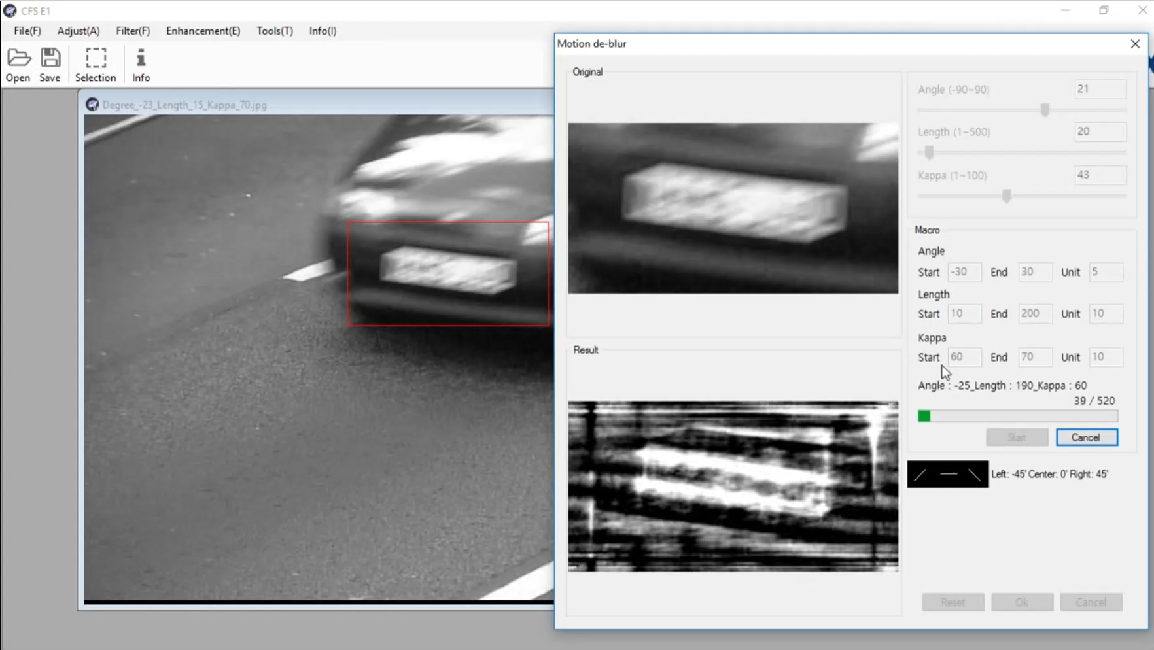
6

Slide 8
Morphological Image Processing
Morphology is a comprehensive set of image processing operations that process images based on shapes. Morphological operations apply a structuring element to an input image, creating an output image of the same size. In a morphological operation, the value of each pixel in the output image is based on a comparison of the corresponding pixel in the input image with its neighbors.
7

Slide 9
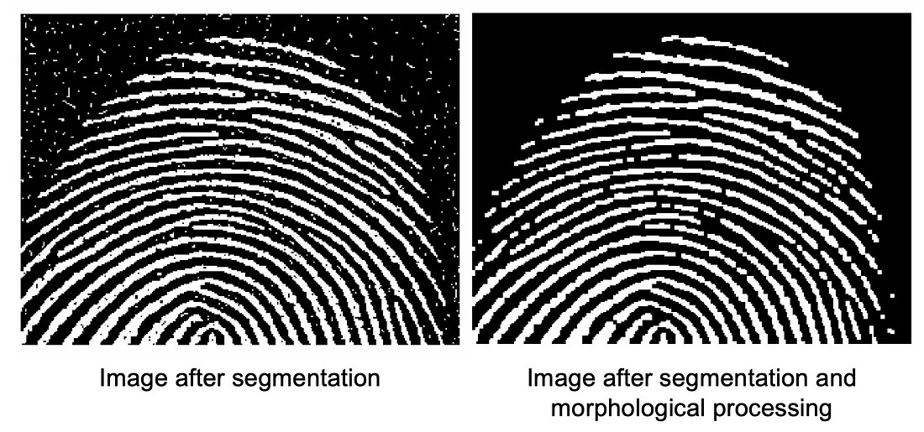
Morphological Image Processing
There is a slight overlap between Morphology and Image Segmentation. Morphology consists of methods that can be used to pre-process the input data of Image Segmentation or to post-process the output of the Image Segmentation stage. In other words, once the segmentation is complete, morphological operations can be used to remove imperfections in the segmented image and deliver information on the shape and structure of the image as shown in the following.
8

Slide 10
Terminologies in Morphological Image Processing
All morphological processing operations are based on mentioned terms.
Structuring Element: It is a matrix or a small-sized template that is used to traverse an image. The structuring element is positioned at all possible locations in the image, and it is compared with the connected pixels. It can be of any shape.
Fit: When all the pixels in the structuring element cover the pixels of the object, we call it Fit.
Hit: When at least one of the pixels in the structuring element cover the pixels of the object, we call it Hit.
Miss: When no pixel in the structuring element cover the pixels of the object, we call it miss.
9

Slide 11
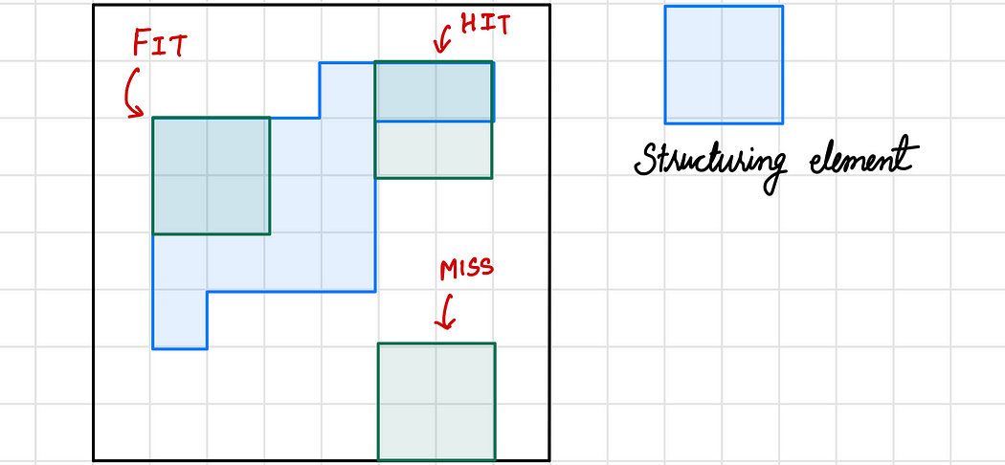
10

Slide 12
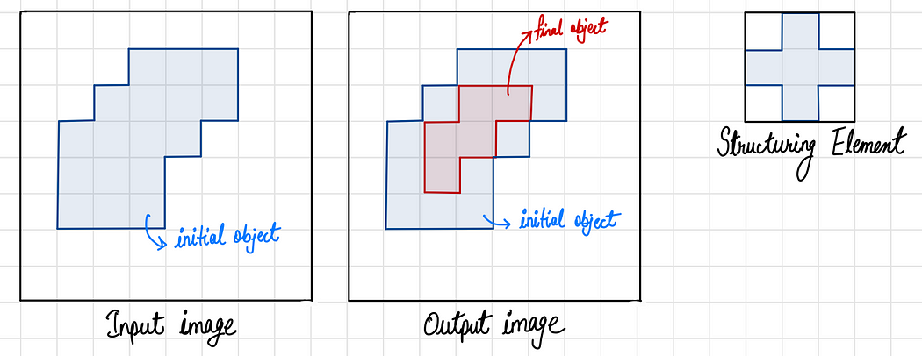
Erosion
Erosion shrinks the image pixels, or erosion removes pixels on object boundaries.
Pixel (output) = 1 {if FIT} Pixel (output) = 0 {otherwise}
11

Slide 13
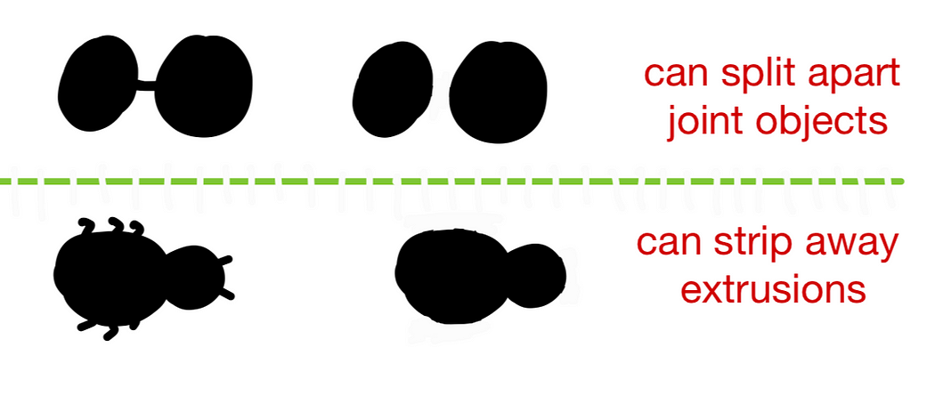
Erosion Properties
12

Slide 14
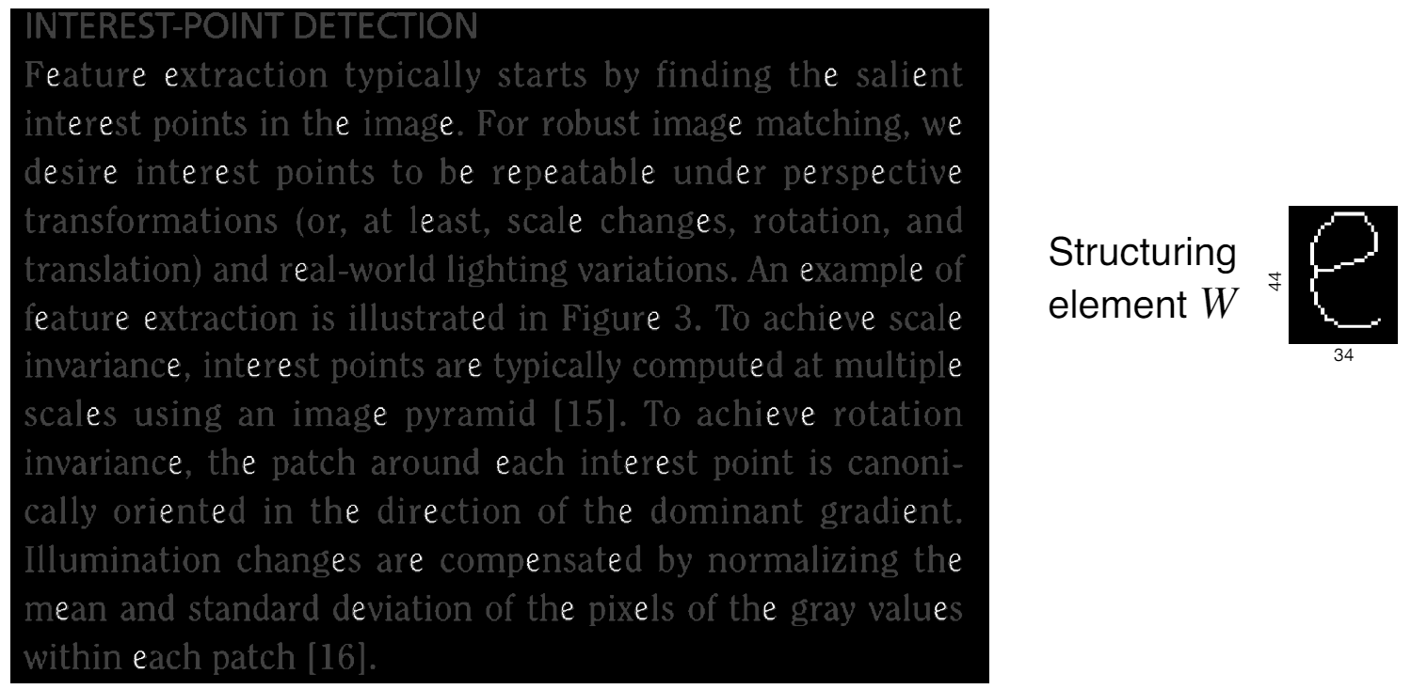
Recognition by erosion
Digital Image Processing: Bernd Girod, © 2013-2018 Stanford University -- Morphological Image Processing 20
13

Slide 15
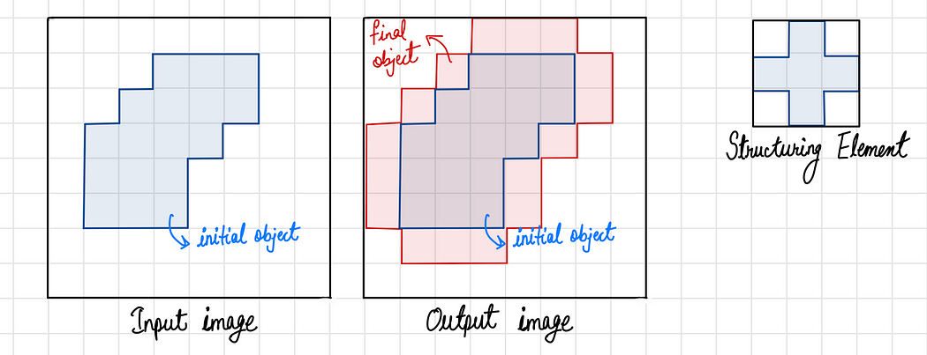
Dilation
Dilation expands the image pixels, or it adds pixels on object boundaries.
The output pixel values are calculated using the following equation. Pixel (output) = 1 {if HIT} Pixel (output) = 0 {otherwise}
14

Slide 16
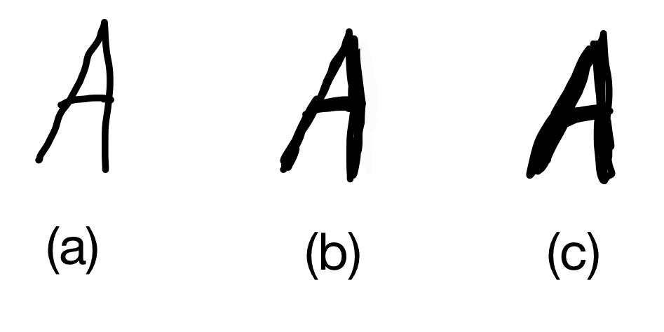
The following figure (a) represents original image, (b) and (c) shows processed images after dilation using 3x3 and 5x5 structuring elements respectively.
15

Slide 17
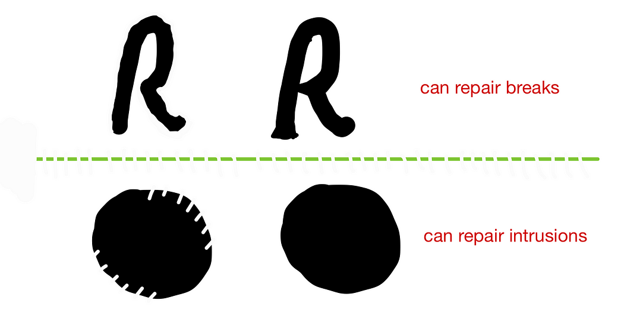
Dilation Properties
16

Slide 18
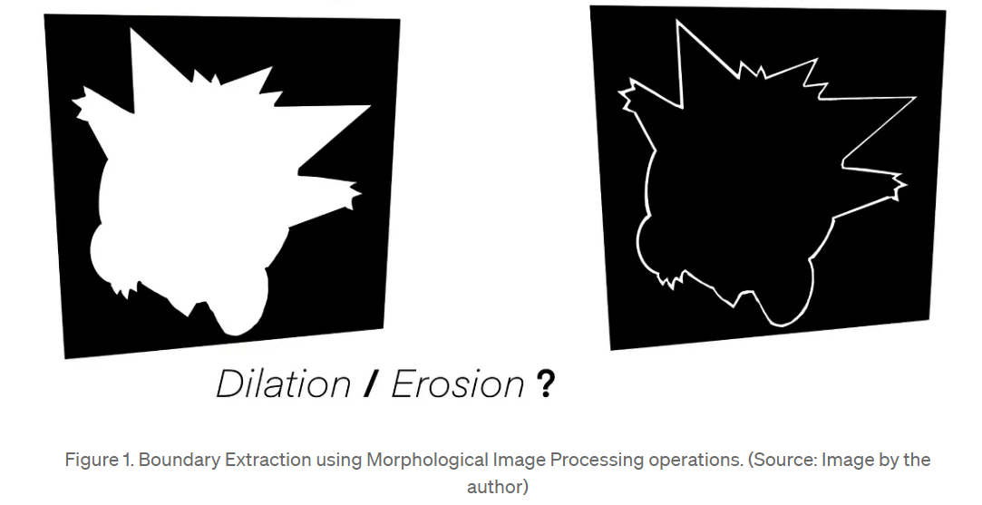
Edge detection
17

Slide 19
Edge detection
Extracting the boundary is an important process to gain information and understand the feature of an image. It is the first process in preprocessing to present the image’s characteristics. This process can help the researcher to acquire data from the image. We can perform boundary extraction of an object by following the below steps.
Step 1. Create an image (E) by erosion process; this will shrink the image slightly. The kernel size of the structuring element can be varied accordingly.
Step 2. Subtract image E from the original image. By performing this step, we get the boundary of our object as in the previous picture
18

Slide 20
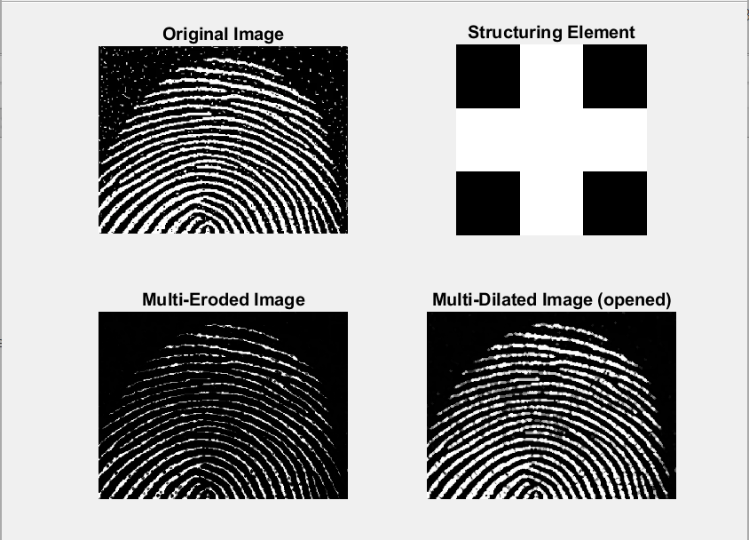
Summary
There are 4 major operations (dilation, erosion, opening, closing)
dilation → to enhance the detected edges
erosion → to reduce some noises in images
opening - erosion then dilation -› example: analysis of fingerprint
closing - dilation then erosion -› example: painting restoration
19

Slide 21
References
[1] P. Chhikara, “Understanding Morphological Image Processing and Its Operations,” Medium. Accessed: May 05, 2024. [Online]. Available: https://towardsdatascience.com/understanding-morphological-image-processing-and-its-operations-7bcf1ed11756
[2] “7-Morphological.pdf.” Accessed: May 01, 2024. [Online]. Available: https://web.stanford.edu/class/ee368/Handouts/Lectures/2018_Winter/7-Morphological.pdf
20

Slide 22
Thank You

